Slide 1
Chapter 13 Multiple Regression
Copyright © 2022 McGraw Hill. All rights reserved. No reproduction or distribution without the prior written consent of McGraw Hill.
1-1

Slide 2
Chapter Learning Objectives
Chapter 13
LO13-1: Use a fitted multiple regression equation to make predictions.
LO13-2: Use the ANOVA table to perform an F test for overall significance.
LO13-3: Construct confidence intervals for coefficients and test predictors for significance.
LO13-4: Calculate the standard error and construct approximate confidence and prediction intervals for Y.
LO13-5: Incorporate categorical variables into a multiple regression model.
LO13-6: Perform basic tests for nonlinearity and interaction.
LO13-7: Detect multicollinearity and assess its effects.
LO13-8: Analyze residuals to check for violations of residual assumptions.
LO13-9: Identify unusual residuals and tell when they are outliers.
LO13-10: Identify high leverage observations and their possible causes.
LO13-11: Explain the purpose of data conditioning and stepwise regression.
LO13-12: Identify when logistic regression is appropriate and calculate predictions for a binary response variable.

Slide 3
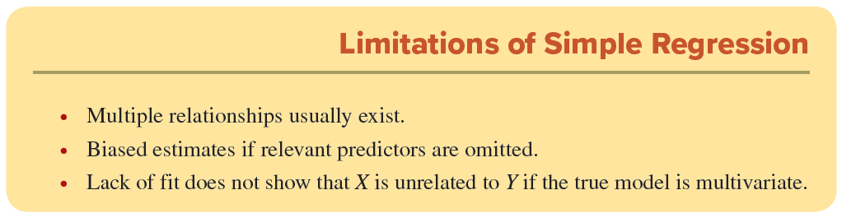
Multiple Regression
LO 13-1
Multiple regression extends simple regression to include several independent variables (called predictors or explanatory variables).
Multiple regression is required when a single-predictor model does not adequately explain the variation in the dependent variable Y (the response variable).
Expanding the regression model to include additional predictors (X1, X2, X3, . . .) can help explain variation and improve predictions.

Slide 4

Multiple Regression
LO 13-1
The response variable (Y) is assumed to be related to the k predictors (X₁, X₂, . . ., X_{k}) by a linear equation called the population regression model:
A random error ε represents everything that is not part of the model.
The unknown regression coefficients β₀, β₁, β₂, . . . , β_{k} are parameters and are denoted by Greek letters.
Each coefficient β_{j} shows the change in the expected value of Y for a unit change in X_{j} while holding everything else constant (ceteris paribus).

Slide 5
Multiple Regression
LO 13-1
The sample estimates of the regression coefficients are denoted by Roman letters b₀, b₁, b₂, . . . , b_{k}.
The predicted value of the response variable is denoted ŷ and is calculated by inserting the values of the predictors into the estimated regression equation:

Slide 6
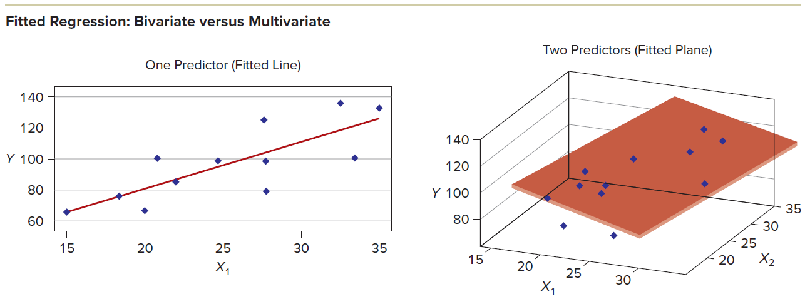
Multiple Regression
LO 13-1
In a simple regression (one predictor), the fitted regression is a line, while in multiple regression (e.g., two predictors), the fitted regression is a surface or plane, as illustrated. If there are more than two predictors, no diagram can be drawn because and the fitted regression is represented by a hyperplane.

Slide 7
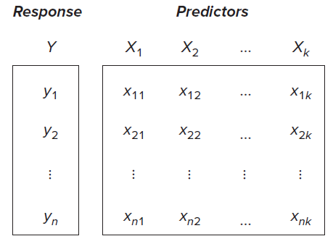
Multiple Regression
LO 13-1
To obtain a fitted regression, we need n observed values of the response variable Y and its proposed predictors X₁, X₂, . . . , X_{k}. A multivariate data set is a single column of Y-values and k columns of X-values.

Slide 8
Regression Modeling
LO 13-1
Naturally, we want predictors that are significant in “explaining” the variation in Y (i.e., predictors that improve the “fit”). But we also prefer predictors that add new information rather than mirroring one another.
Four Criteria for Regression Assessment
Logic Is there an a priori reason to expect a causal relationship between the predictors and the response variable?
Fit Does the overall regression show a significant relationship between the predictors and the response variable?
Parsimony Does each predictor contribute significantly to the explanation? Are some predictors not worth the trouble?
Stability Are the predictors related to one another so strongly that regression estimates become erratic?

Slide 9

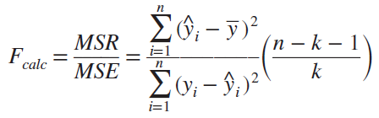
F Test for Significance
LO 13-2
For a regression with k predictors, the hypotheses to be tested are
The basis for the regression F test is the ANOVA table.
The formula for the F test statistic is

Slide 10
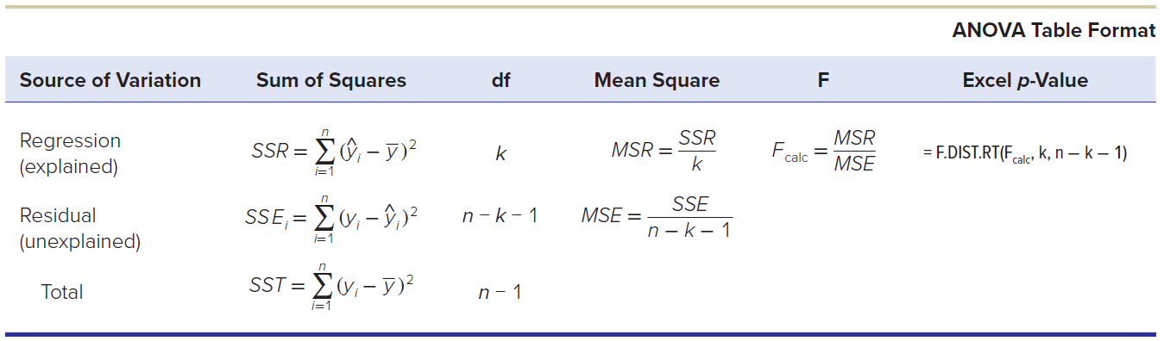
F Test for Significance
LO 13-2
When F_{calc} is close to 1, the values of MSR and MSE are close in magnitude. This suggests that none of the predictors provides a good predictive model for Y (i.e., all β_{j} are equal to 0).
When the value of MSR is much greater than MSE, this suggests that at least one of the predictors in the regression model is significant (i.e., at least one β_{j} is not equal to 0).

Slide 11
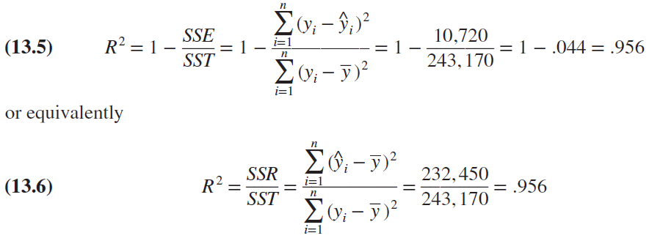
Coefficient of Determination
LO 13-2
The most common measure of overall fit is the coefficient of determination or R², which is based on the ANOVA table’s sums of squares.
It can be calculated in two ways
For example, see the home price data in the text:
For the home price data, the R² statistic indicates that 95.6 percent of the variation in selling price is “explained” by our three predictors.

Slide 12
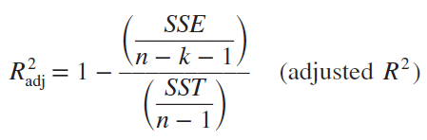
Adjusted R²
LO 13-2
In multiple regression, it is possible to raise the coefficient of determination R2 by including additional predictors.
An adjustment can be made to the R2 statistic to penalize the inclusion of useless predictors.
The adjusted coefficient of determination using n observations and k predictors is

Slide 13
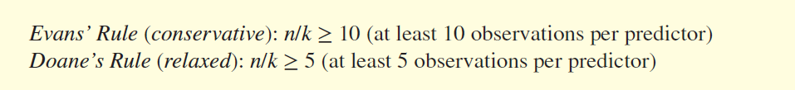
How Many Predictors?
LO 13-2
One way to prevent overfitting the model is to limit the number of predictors based on the sample size.
A conservative rule (Evans’ Rule) suggests that n/k should be at least 10 (i.e., at least 10 observations per predictor).
A more relaxed rule (Doane’s Rule) suggests that n/k be only at least 5 (i.e., at least 5 observations per predictor).
For the home price regression with n = 30 and k = 3 example, n/k = 30/3 = 10, so either guideline is met.

Slide 14
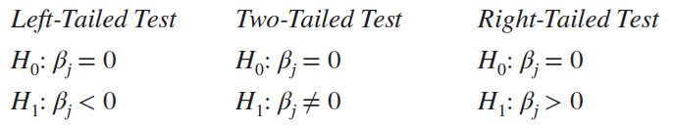
Hypothesis Tests
LO 13-3
Test each fitted coefficient to see whether it is significantly different from zero.
The hypothesis tests for predictor X_{j} are
If we cannot reject the hypothesis that a coefficient is zero, then the corresponding predictor does not significantly contribute to the prediction of Y.

Slide 15
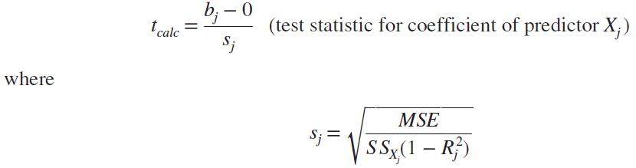
Test Statistic
LO 13-3
The test statistic for coefficient of predictor X_{j} is
Find the critical value t_{α} for a chosen level of significance α from Appendix D.
To reject H₀ we can compare t_{calc} to t_{α} for the different hypotheses or if p-value ≤ α.

Slide 16
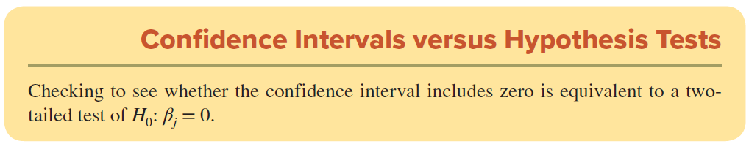
Test Statistic
LO 13-3
To test for a zero coefficient, we could construct a confidence interval for the true coefficient βj and see whether the interval includes zero.
The confidence interval for coefficient β_{j} is

Slide 17
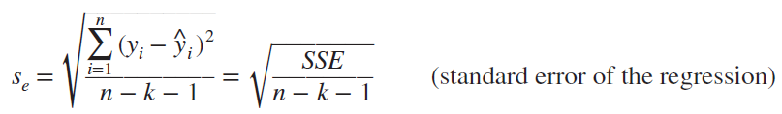
Standard Error
LO 13-3
Another important measure of fit is the standard error (s_{e}) of the regression, derived from the sum of squared residuals (SSE) for n observations and k predictors:
The standard error is measured in the same units as the response variable Y (dollars, square feet, etc.).
A smaller s_{e} indicates a better fit.
If all predictions were perfect, then s_{e} would be zero.

Slide 18
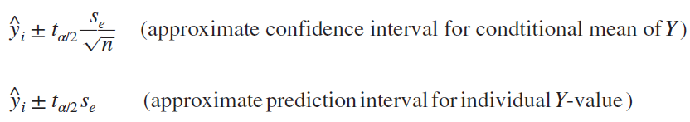
Confidence and Prediction Intervals for Y
LO 13-3
The intervals are most accurate when X₁, X₂, . . . , X_{k} are near their respective means (a reasonable case).
Although these approximate intervals somewhat understate the interval widths, they are helpful when you only need a general idea of the accuracy of your model’s predictions.

Slide 19
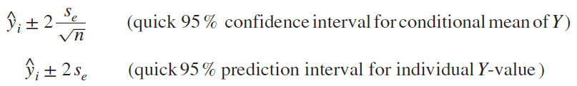
Confidence and Prediction Intervals for Y
LO 13-3
The t-values for a 95 percent confidence level are typically near 2 (as long as n is not too small).
This suggests a quick interval, without using a t table:
These quick formulas are suitable only for rough calculations when you lack access to regression software or t tables.

Slide 20
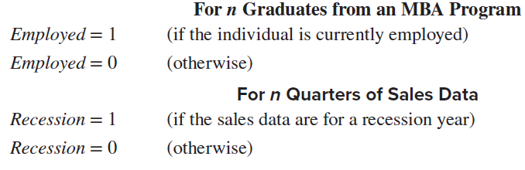
Categorical Variables
LO 13-5
We cannot directly include a categorical variable (qualitative data) as a predictor in a regression because regression requires numerical data (quantitative data).
But through simple data coding, we can convert categorical data into useful predictors.
By coding each category as a binary variable, we have created a binary predictor.

Slide 21
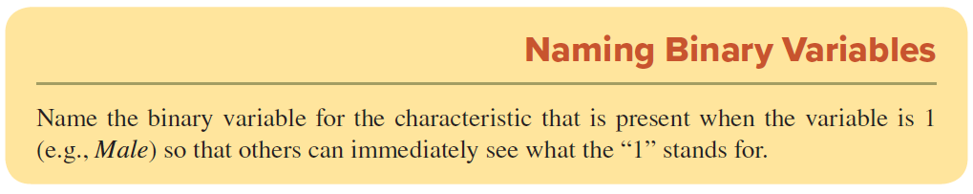
Categorical Variables
LO 13-5
These variables are also called dummy, dichotomous, or indicator variables.
When testing in multiple regression, binary predictors require no special treatment. They are tested as any other predictor, using a t test.

Slide 22
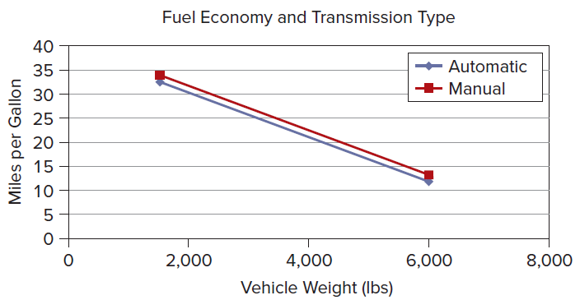
Effects of a Binary Predictor
LO 13-5
A binary predictor is sometimes called a shift variable because it shifts the regression plane up or down.
Suppose X₁ is a binary predictor that can take on only the values of 0 or 1.
Its contribution to the regression is either b₁ or nothing, resulting in an intercept of either b₀ (when X₁ = 0) or b₀ + b₁ (when X₁ = 1).
slope does not change, only the intercept is shifted. For example:

Slide 23
More Than One Binary
LO 13-5
More than one binary occurs when the number of categories to be coded exceeds two.
For example, for the variable GPA by class level, each category is a binary variable.
Freshman = 1 if the student is a freshman, 0 otherwise
Sophomore = 1 if the student is a sophomore, 0 otherwise
Junior = 1 if the student is a junior, 0 otherwise
Senior = 1 if the student is a senior, 0 otherwise
Master’s = 1 if the student is a master’s candidate, 0 otherwise
Doctoral = 1 if the student is a PhD candidate, 0 otherwise

Slide 24
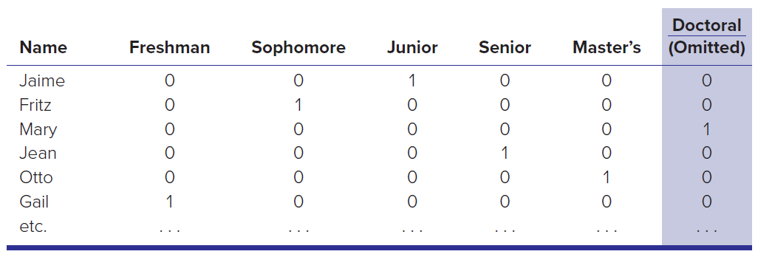
More Than One Binary
LO 13-5
Because only one column can be 1 and the other columns must be 0, the following relation holds:
That Mary is a doctoral student can be inferred from the fact that 0 appears in all the other columns. Because Mary is not in any of the other five categories, she must be in the sixth category.

Slide 25
What If I Forget to Exclude One Binary?
LO 13-5
Including all binaries for all categories may introduce a serious problem of collinearity for the regression estimation. Collinearity occurs when there are redundant independent variables.
When the value of one independent variable can be determined from the values of other independent variables, one column in the X data matrix will be a perfect linear combination of the other column(s).
The least squares estimation would fail because the data matrix would be singular (i.e., would have no inverse).

Slide 26
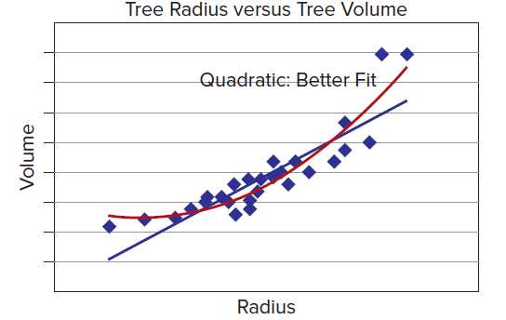
Tests for Nonlinearity
LO 13-6
Sometimes the effect of a predictor is nonlinear.
In the example below shows the volume of lumber that can be milled compared to the radius of the trunk.
You’ll see that the quadratic model fits the data better than a linear model.

Slide 27


Tests for Nonlinearity
LO 13-6
To test for suspected nonlinearity of any predictor, we can include its square in the regression. For example, instead of
We would use
Squared predictors add model complexity and impose a cost of reduced degrees of freedom for significance tests (we lose 1 degree of freedom for each squared predictor), but the potential reward is a more appropriate model specification.

Slide 28

Multiplicative Models
LO 13-6
We can use linear regression to estimate exponents in a multiplicative model (as opposed to an additive model). The Cobb-Douglas model of production with k inputs x1, x2, . . ., xk is an example:
Although the exponents in this model cannot be directly estimated using Excel, by taking logs of both sides, we obtain a transformed model that is now in a linear form. The coefficients of the log expression can be estimated using least squares:

Slide 29

Tests for Interaction
LO 13-6
We can test for interaction between two predictors by including their product in the regression. For example, we might hypothesize that Y depends on X₁ and X₂, and X₁X₂. To test for interaction, we estimate the model:
Interaction effects require careful interpretation and cost 1 degree of freedom per interaction.
However, if the interaction term improves the model specification, it is well worth the cost.

Slide 30
Multicollinearity
LO 13-7
When the independent variables X₁, X₂, . . ., X_{m} are related to each other instead of being independent, we have a condition known as multicollinearity.
Multicollinearity does not bias the least squares estimates or the predictions for Y, but it does induce variance inflation.
When predictors are strongly intercorrelated, the variances of their estimated coefficients tend to become inflated, widening the confidence intervals for the true coefficients β₁, β₂, . . ., β_{k} and making the t statistics less reliable.
It can thus be difficult to identify the separate contribution of each predictor to “explaining” the response variable, due to the entanglement of their roles.
There are several ways to investigate the degree of multicolinearity in the regression model.

Slide 31
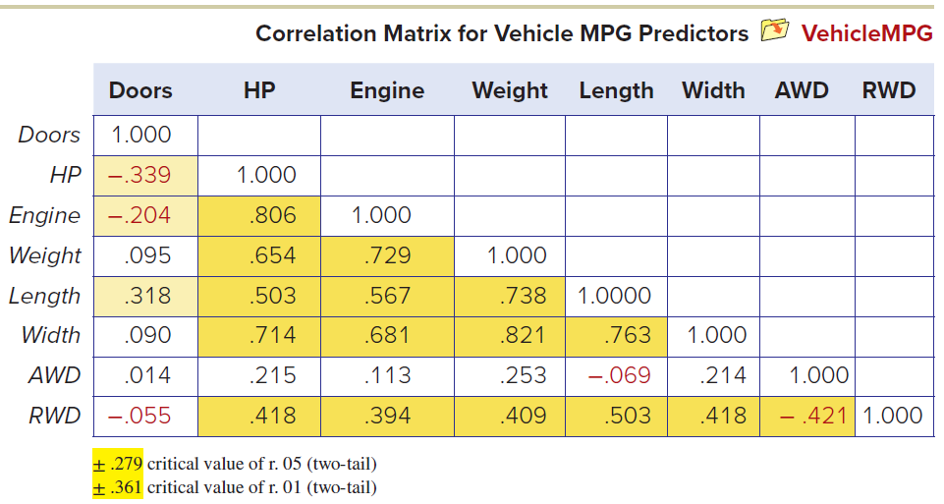
Correlation Matrix
LO 13-7
To check whether two predictors are correlated (collinearity), we can inspect the correlation matrix for the predictors using Excel’s Data Analysis > Correlation.
In this example, a majority of the predictors are significantly correlated, which is not an unusual situation in regression modeling.

Slide 32

Variance Inflation Factor
LO 13-7
The variance inflation factor (VIF) for each predictor provides a more comprehensive test. For a given predictor Xj, the VIF is defined as
where R j 2 is the coefficient of determination when predictor j is regressed against all the other predictors (excluding Y).

Slide 33
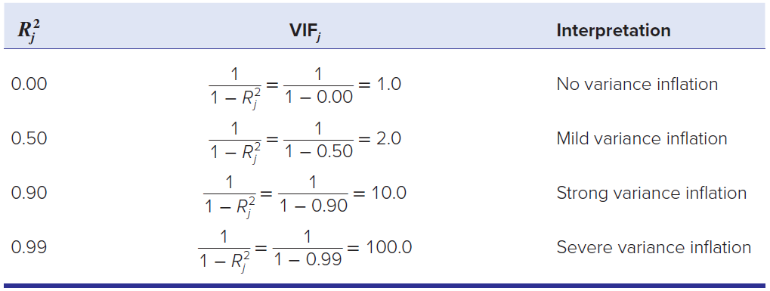
Variance Inflation Factor
LO 13-7
If predictor j is unrelated to the other predictors, its R_{j}² will be 0 and its VIF will be 1 (an ideal situation that will rarely be seen with actual data). Some possible situations are

Slide 34
What to Do about Multicollinearity?
LO 13-7
There is no limit on the magnitude of the VIF.
A VIF of 10 says that the other predictors “explain” 90% of the variation in predictor j.
This indicates that predictor j is strongly related to the other predictors.
However, it is not necessarily indicative of instability in the least squares estimate.
A large VIF is a warning to consider whether predictor j really belongs to the model.

Slide 35
Are Coefficients Stable?
LO 13-7
Evidence of instability is when X₁ and X₂ have a high pairwise correlation with Y, yet one or both predictors have insignificant t statistics in the fitted multiple regression, and/or if X₁ and X₂ are positively correlated with Y, yet one has a negative slope in the multiple regression.
As a general test, you can try dropping a collinear predictor from the regression and watch what happens to the fitted coefficients in the reestimated model.
If they do not change very much, multicollinearity was probably not a concern.
If dropping one collinear predictor causes sharp changes in one or more of the remaining coefficients in the model, then your multicollinearity may be causing instability.

Slide 36
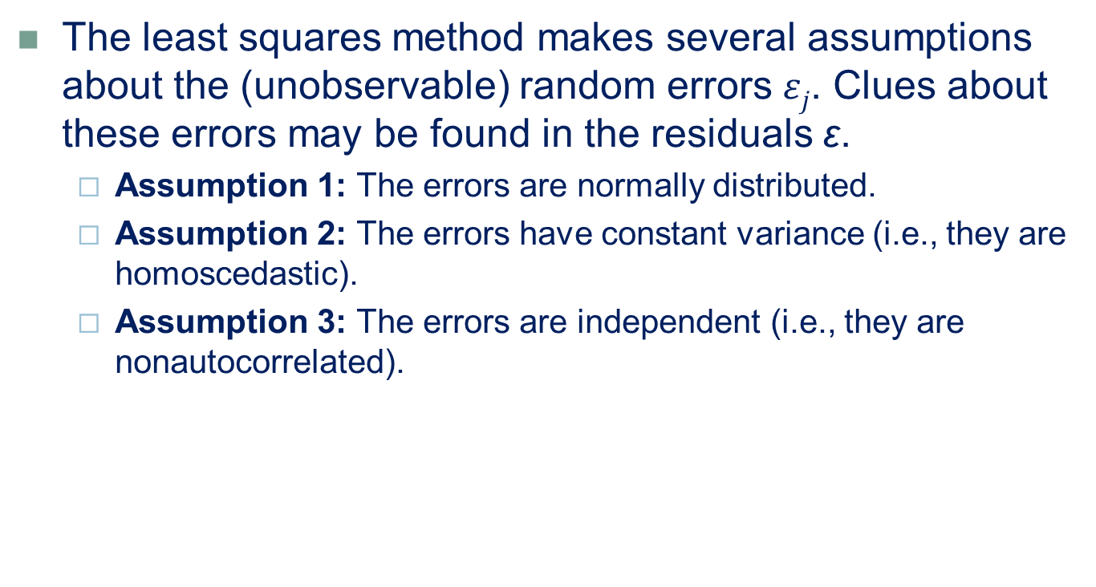
Regression Diagnostics
LO 13-8
The least squares method makes several assumptions about the (unobservable) random errors $εj$. Clues about these errors may be found in the residuals ε.
Assumption 1: The errors are normally distributed.
Assumption 2: The errors have constant variance (i.e., they are homoscedastic).
Assumption 3: The errors are independent (i.e., they are nonautocorrelated).

Slide 37
#1: Non-Normal Errors
LO 13-8
The main ill consequence is that confidence intervals for the parameters may be unreliable because the normality assumption is used to construct them.
The hypotheses are
H₀: Errors are normally distributed
H₁: Errors are not normally distributed
Create a histogram of residuals (plain or standardized) to visually reveal any outliers or serious asymmetry.
The normal probability plot will also visually test for normality.

Slide 38
#2: Nonconstant Variance (Heteroscedasticity)
LO 13-8
The regression should fit equally well for all values of X or Y.
This desirable property is called homoscedasticity. If the error variance is constant, the errors are homoscedastic.
If the error variance is nonconstant, we have heteroscedasticity and say that the errors are heteroscedastic.
The hypotheses are
H₀: Errors have constant variance (homoscedastic)
H₁: Errors have nonconstant variance (heteroscedastic)
Constant variance can be visually tested by examining scatter plots of the residuals against each predictor.
Ideally there will be no pattern.
Violation of the constant variance assumption is potentially serious.

Slide 39
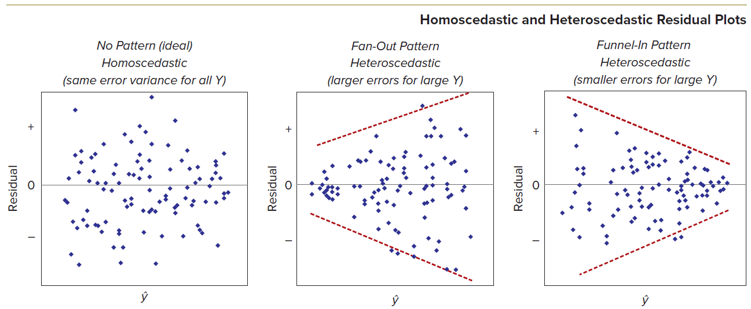
#2: Nonconstant Variance (Heteroscedasticity)
LO 13-8
Although many patterns of non-constant variance might exist, the “fan-out” pattern of increasing variance is most common.

Slide 40
#3: Autocorrelation
LO 13-8
Autocorrelation is a pattern of nonindependent errors that violates the regression assumption that each error is independent of its predecessor.
This is a problem with time series data.
Autocorrelated errors results in biased estimated variances which will result in narrow confidence intervals and large t statistics.
The hypotheses are
H₀: Errors are nonautocorrelated
H₁: Errors are autocorrelated

Slide 41
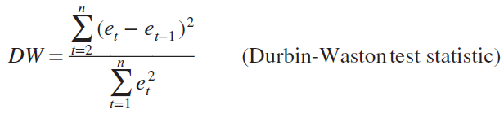
#3: Autocorrelation
LO 13-8
We will use the observable residuals e₁, e₂, …, e_{n} for evidence of autocorrelation and the Durbin-Watson test statistic DW:
The DW statistic lies between 0 and 4.
When H0 is true (no autocorrelation), the DW statistic will be near 2.
A DW < 2 suggests positive autocorrelation.
A DW > 2 suggests negative autocorrelation.
Ignore the DW statistic for cross-sectional data.

Slide 42
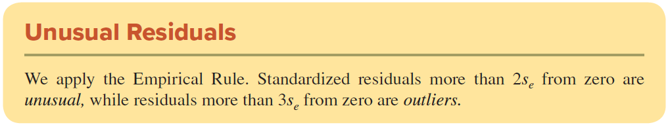
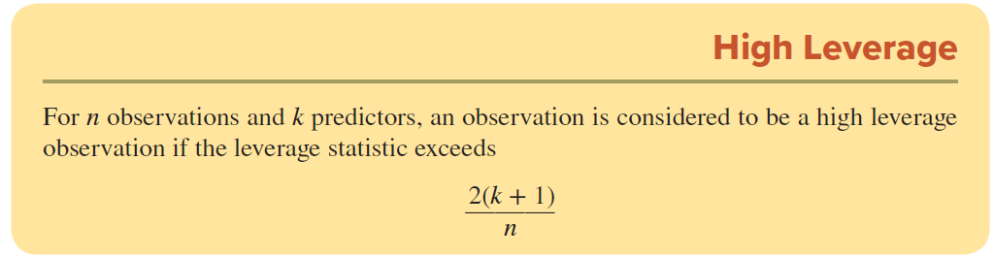
Unusual Observations
LO 13-10
An observation may be unusual for two reasons:
because the fitted model’s prediction is poor (unusual residuals) or
because one or more observations may be having a large influence on the regression estimates (high leverage).

Slide 43
Outliers
LO 13-11
An outlier may be due to an error in recording the data. If so, the observation should be deleted.
But how can you tell?
Impossible or truly bizarre data values are apparent reasons to discard an observation.

Slide 44
Missing Predictors
LO 13-11
An outlier also may be an observation that has been influenced by an unspecified “lurking” variable that should have been controlled but wasn’t.
In this case, we should try to identify the lurking variable and formulate a multiple regression model that includes both predictors.
If there are unspecified “lurking” variables, our fitted regression model will not give accurate predictions.

Slide 45
Ill-Conditioned Data
LO 13-11
All variables in the regression should be of the same general order of magnitude (not too small, not too large).
If your coefficients come out in exponential notation (e.g., 7.3154 E+06), you probably should adjust the decimal point in one or more variables to a convenient magnitude, as long as you treat all the values in the same data column consistently.

Slide 46
Significance in Large Samples
LO 13-11
Statistical significance may not imply practical importance.
In a large sample, we can obtain very large t statistics with low p-values for our predictors when, in fact, their effect on Y is very slight.
There is an old saying in statistics that you can make anything significant if you get a large enough sample.

Slide 47
Model Specification Errors
LO 13-11
If you estimate a linear model when actually a nonlinear model is required or when you omit a relevant predictor, then you have a misspecified model.
In order to detect misspecification you can
Plot the residuals against estimated Y (should be no discernable pattern).
Plot the residuals against actual Y (should be no discernable pattern).
Plot the fitted Y against the actual Y (should be a 45-degree line).
You can start by looking for a missing relevant predictor, seek a model with a better theoretical basis, or try transforming your variables

Slide 48
Missing Data
LO 13-11
If many values in a data column are missing, we might want to discard that variable.
If a Y data value is missing, we must discard the entire observation.
If any X data values are missing, the conservative action is to discard the entire observation.

Slide 49
Stepwise and Best Subsets Regression
LO 13-11
Stepwise regression uses the power of the computer to fit the best model using 1, 2, 3, . . ., k predictors.
In backward elimination, we start with all predictors in the model, removing at each stage the predictor with the highest p-value greater than α, stopping when there are no more predictors with p-values greater than α to be removed.
In forward selection, we start with the single best predictor, adding at each stage the next best predictor in terms of increasing R², until there are no more predictors with p-values less than α to be added to the model.
In best subsets regression, we try all possible combinations of predictors and then choose the best model for the number of predictors we feel are justified (e.g., by Evans’ Rule).

Slide 50
Logistic Regression
LO 13-12
Sometimes we need to predict something that has only two possible values (a binary dependent variable).
In Chapter 12 you saw logistic regression (sometimes called logit) with a single predictor.
Now we can extend this model to include multiple predictors x₁, x₂, . . ., x_{k}, which is more realistic in applied data analytics.

Slide 51
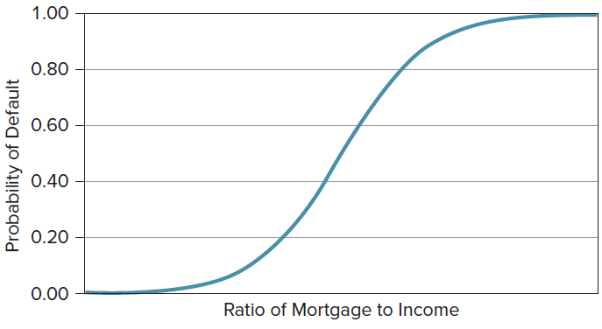

Logistic Regression
LO 13-12
The logistic regression equation resembles a simple logistic regression except that the exponent includes k predictors.
This fitted model predicts the probability that Y = 1 for specified values of the independent variables x₁, x₂, . . ., x_{k}. This nonlinear model form ensures predictions within the range 0 < ^y < 1.

Slide 52
Estimating a Logistic Regression Model
LO 13-12
We use the method of maximum likelihood to choose the values of the regression parameters that will maximize the probability of obtaining the observed sample data.
An iterative process is required because there is no simple formula for the parameter estimates b₀, b₁, . . . , b_{k}.
Because we cannot use Excel, specialized software is required.

Slide 53
Estimating a Logistic Regression Model
LO 13-12
As a minimum, we want at least 10 observations per predictor, and many experts recommend even more.
To achieve a parsimonious model, a common method is to start with the full model (all predictors included) and to use backward stepwise regression to eliminate the weakest predictors until further elimination would weaken the overall model (according to whatever criterion has been selected).

Slide 54
Chapter 13 Practice Problems

Slide 55
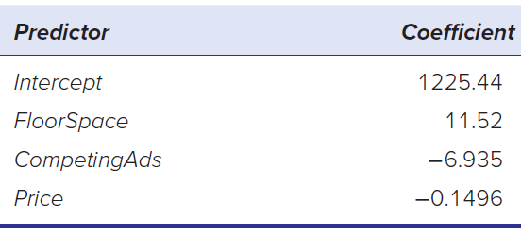
Question 2
LO 13-1
Observations are taken on sales of a certain mountain bike in 30 sporting goods stores. The regression model was Y = total sales (thousands of dollars),
X1 = display floor space (square meters), X2 = competitors’ advertising expenditures (thousands of dollars), X3 = advertised price (dollars per unit).
a. Write the fitted regression equation.
b. Interpret each coefficient.
c. Would the intercept seem to have meaning in this regression?
d. Make a prediction for Sales when FloorSpace = 80, CompetingAds = 100, and Price = 1,200. *Bikes Data

Slide 56
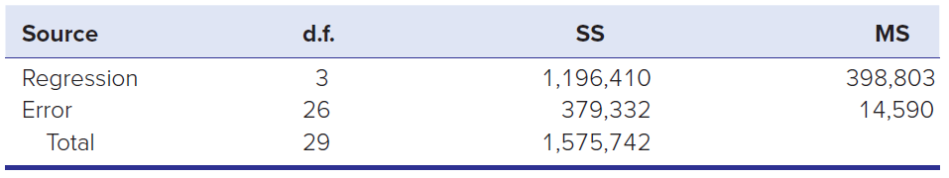
Question 6
LO 13-2
Refer to the ANOVA table below.
a. State the degrees of freedom for the F test for overall significance.
b. Use Appendix F to look up the critical value of F for α = .05.
c. Calculate the F statistic. Is the regression significant overall?
d. Calculate R2 and Ra d j2, showing your formulas clearly.
*Bikes Data

Slide 57
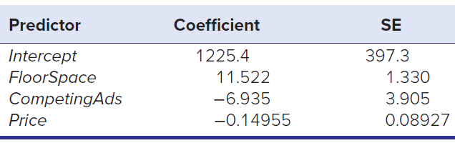
Question 10
LO 13-3
Observations are taken on sales of a certain mountain bike in 30 sporting goods stores. The regression model was Y = total sales (thousands of dollars), X1 = display floor space (square meters), X2 = competitors’ advertising expenditures (thousands of dollars), X3 = advertised price (dollars per unit).
a. Calculate the t statistic for each coefficient to test for β = 0.
b. Look up the critical value of Student’s t in Appendix D for a two-tailed test at α = .01. Which coefficients differ significantly from zero?
c. Use Excel to find the p-value for each coefficient.
*Bikes Data

Slide 58
Question 13
LO 13-4
A regression of accountants’ starting salaries in a large firm was estimated using 40 new hires and five predictors (college GPA, gender, score on CPA exam, years’ prior experience, size of graduating class). The standard error was $3,620. Find the approximate width of a 95 percent prediction interval for an employee’s salary, assuming that the predictor values for the individual are near the means of the sample predictors.

Slide 59
Question 16
LO 13-5
A regression model to predict the price of diamonds included the following predictor variables: the weight of the stone (in carats where 1 carat = 0.2 gram), the color rating (D, E, F, G, H, or I), and the clarity rating (IF, VVS1, VVS2, VS1, or VS2).
a. Identify the quantitative predictor variable(s).
b. How many indicator variables would be included in the model in order to prevent the least squares estimation from failing?
c. Write the proposed model form for predicting a diamond price.

Slide 60
Question 21
LO 13-7
Using the “Resort Guest Satisfaction Survey” data, construct a correlation matrix of the 11 independent variables. The response variable is ovalue.
a. Identify the four pairs of independent variables that have the highest pairwise correlation values. Do they show significant correlation?
b. Run the regression with all 11 predictor variables and calculate the VIF for each predictor. Use software such as MegaStat or Minitab.
c. Did you see any cause for concern based on the VIF values? Why or why not?

Slide 61
Question 23
LO 13-10
Which would be “high leverage” observations?
a. Leverage hi = .15 in a regression with 5 predictors and 72 observations.
b. Leverage hi = .18 in a regression with 4 predictors and 100 observations.
c. Leverage hi = .08 in a regression with 7 predictors and 240 observations.

Slide 62
Chapter 13 Analytics in Action

Slide 63


